Slide 1
Car Plate Recognition and Reconstruction with Deep Learning
Alessandro Tagliaferri – Federico Navarra
Computer Vision 2024-2025
Sapienza University of Rome

Slide 2
Table of contents
Task overview
Dataset
State of the Art
Proposed methods
Results
Conclusions

Slide 3
Task overview
Objectives
Implement a simple baseline for both detection and recognition.
Reproduce the proposed pipeline: → YOLOv5 for detection → PDLPR for recognition
Train, evaluate, and compare models on a real-world dataset (CCPD).
Investigate alternative recognition models beyond those strictly required.
The goal is to develop a complete pipeline for Car Plate Detection and Recognition using Deep Learning.

Slide 4
Two parts
Detection
Predict plate box on the image and crop it
Recognition
Recognize plate number from cropped image

Slide 5
Dataset
Key Features:
Over 250,000 images of cars with visible license plates.
Captured in unconstrained scenarios: varying lighting, angles, distances, occlusions, and weather conditions.
Each image comes with annotated bounding boxes and plate text labels.
Plate numbers include both Chinese characters and alphanumeric digits.
CCPD 2019 dataset

Slide 6
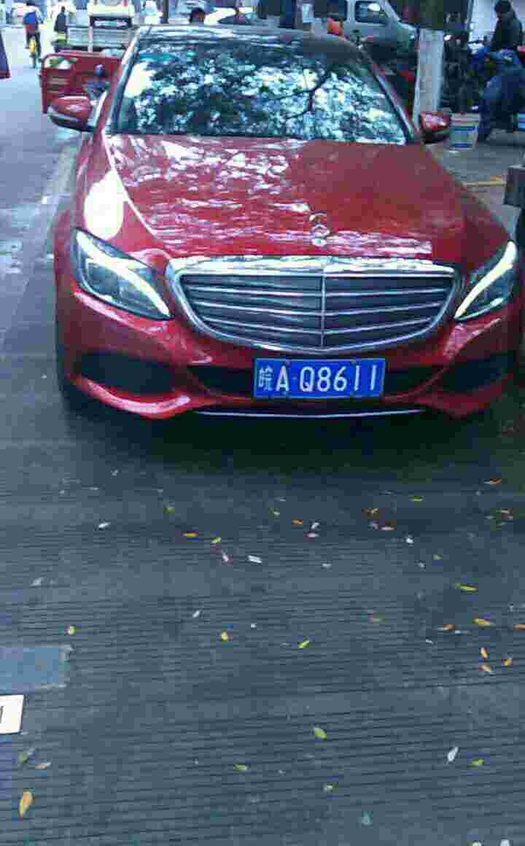
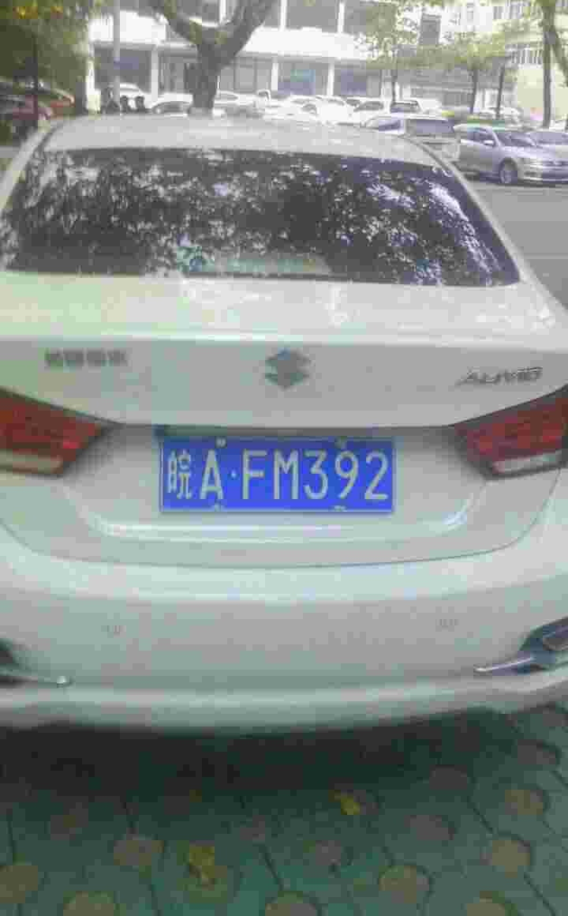
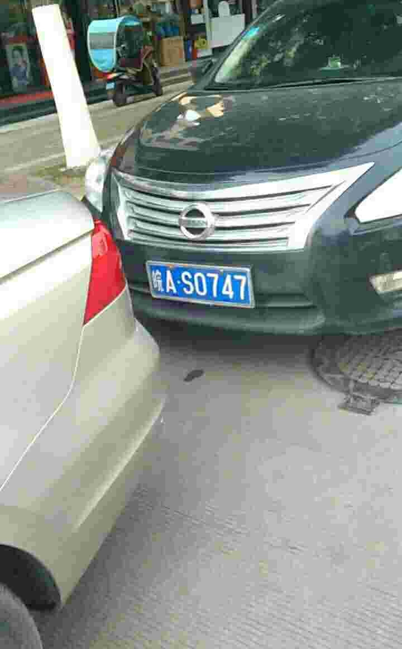
CCPD 2019

Slide 7
State of the art
Most recent works adopt a two-stage pipeline:
1. Detection: Locate the license plate in the input image.
2. Recognition: Decode the characters from the cropped plate.
Detection is typically solved with object detection models (YOLO, Faster R-CNN, SSD...).
Recognition relies on OCR Engines or Deep Learning OCR Models
Two steps approach

Slide 8
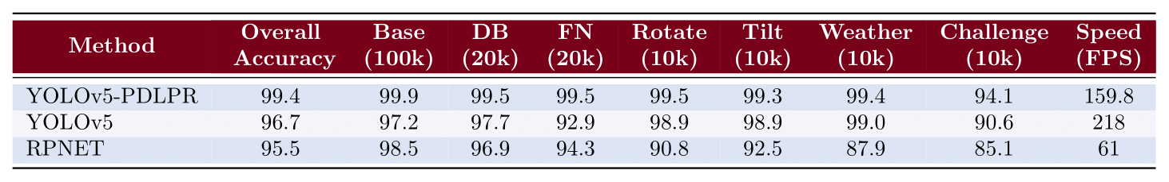
S.O.T.A

Slide 9
Proposed methods
We implemented a simple baseline for both detection and recognition
We reproduced and trained the YOLOv5 + PDLPR model as proposed in the reference paper
Explored alternative models like Holistic CNN, LPRNET and CRNN for recognition
Trained and evaluated all models on the CCPD dataset, using consistent metrics
From Baseline to Final Model

Slide 10
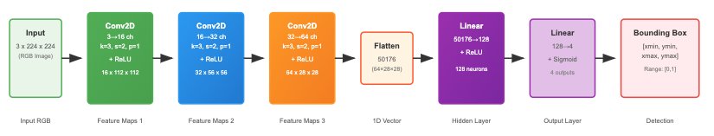
Detection – Baseline with SimpleCNN

Slide 11

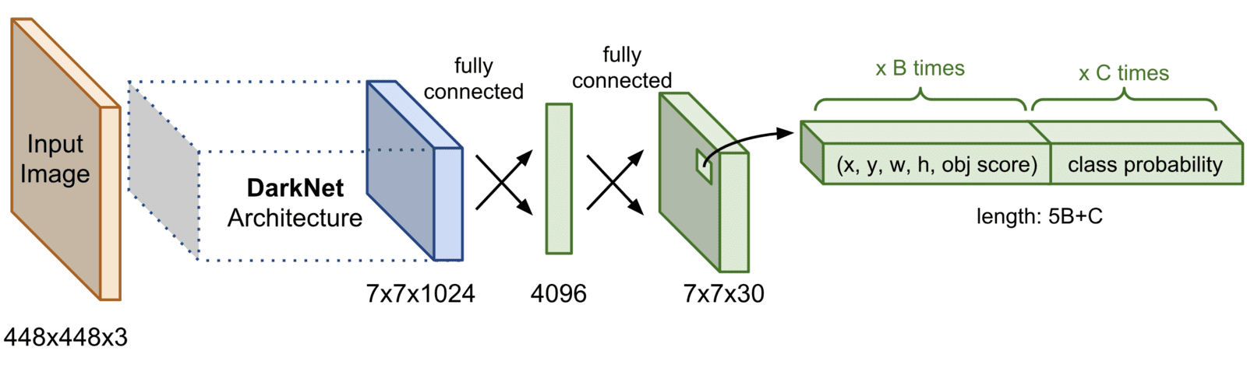
Detection – Yolov5s for Plate Recognition
One-stage detector with real-time performance
High detection speed with good accuracy
Uses CSPDarknet backbone and PANet for feature fusion
Outputs bounding boxes with confidence scores
Fine-tuned on CCPD with pretrained COCO weights
Cropped plates from YOLO detections with IoU>0.6 used for recognition

Slide 12
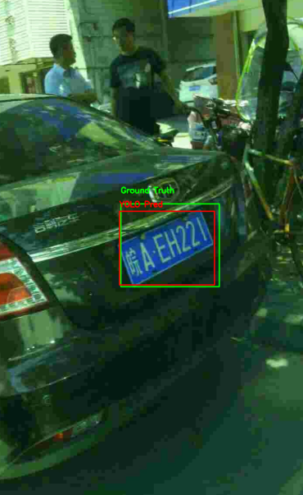
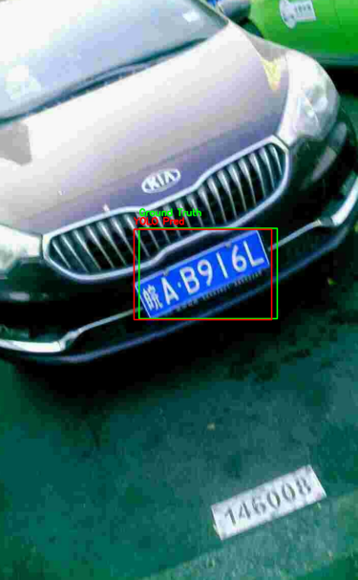
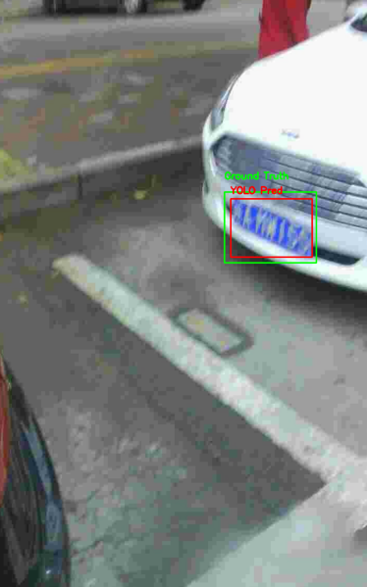
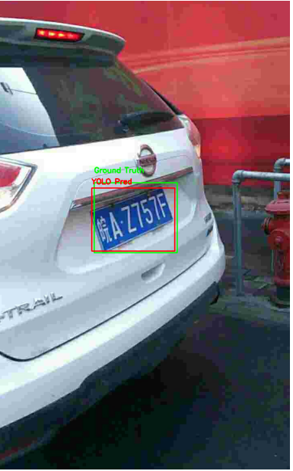
Detection with Yolo

Slide 13
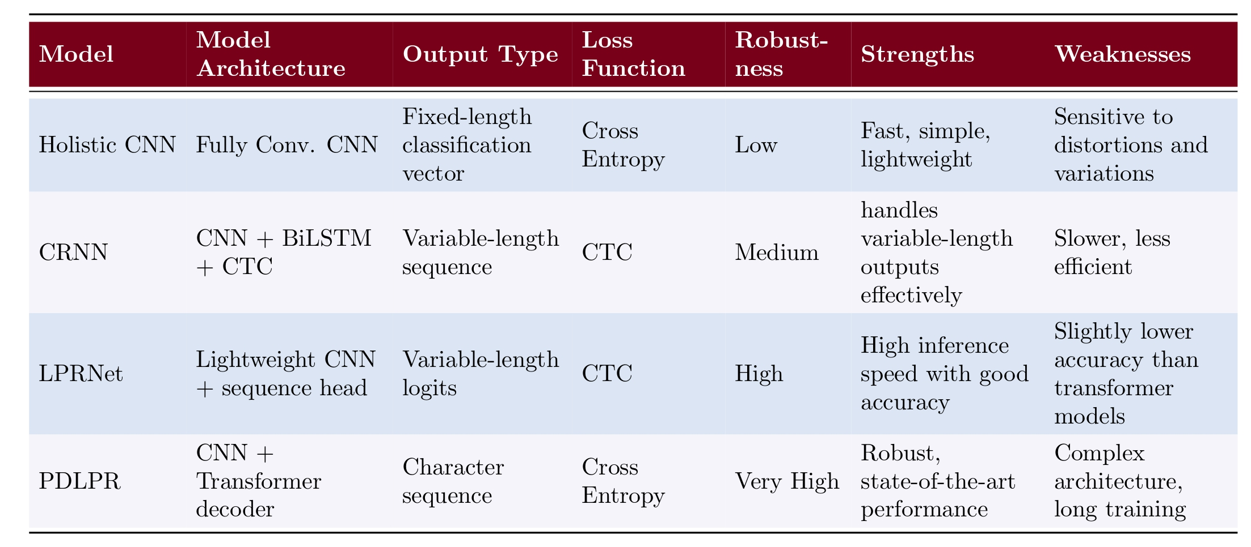
Recogniction - Holistic CNN vs CRNN vs LPRNet

Slide 14
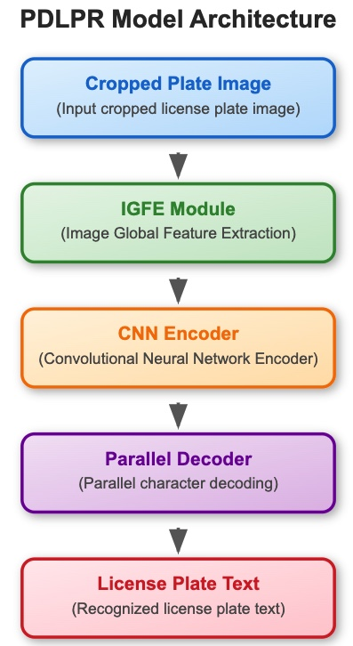
PDLPR - License Plate Character Recognition
2 small CNN branches - Extracts geometry-aware features
CNN - Encodes visual/textual features
7 classification heads - Predicts all characters in parallel

Slide 15



Our setup
DATASET
100k images sampled from CCPD-base
Train/Eval 80/20
Used cropped plates from YOLOv5 with IoU > 0.6 for recognition training
DETECTION
Pretrained YOLOv5s
Fine-tuned on our subset
RECOGNITION
Input: 48×144 cropped plates
Augmentations: color jitter, rotation, erasing

Slide 16
Results
Detection performance: YOLOv5 outperforms CNN baseline
Recognition accuracy: PDLPR shows best results among tested models
CRNN and Holistic CNN show competitive performance but lower generalization
Visual samples: detection boxes + predicted license plates
Error cases: mainly due to occlusion, blur or incorrect crops
Performance results and output plots

Slide 17
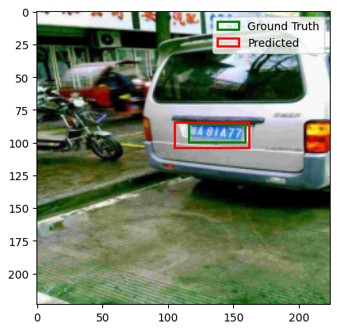
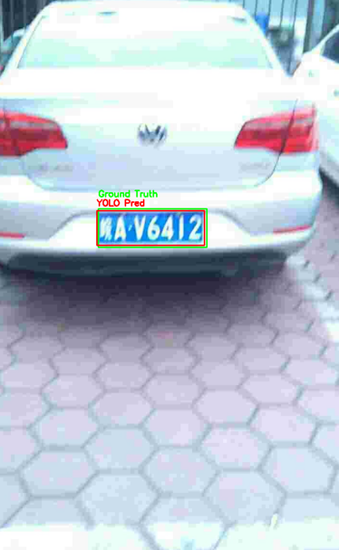
Detection – SimpleCNN vs Yolov5s
Yolo_v5 predicts well 99% of images
CNN predicts well around 57% of images
The bounding box is considered to be correct if and only if its IoU with the ground truth bounding box is more than 70%

Slide 18
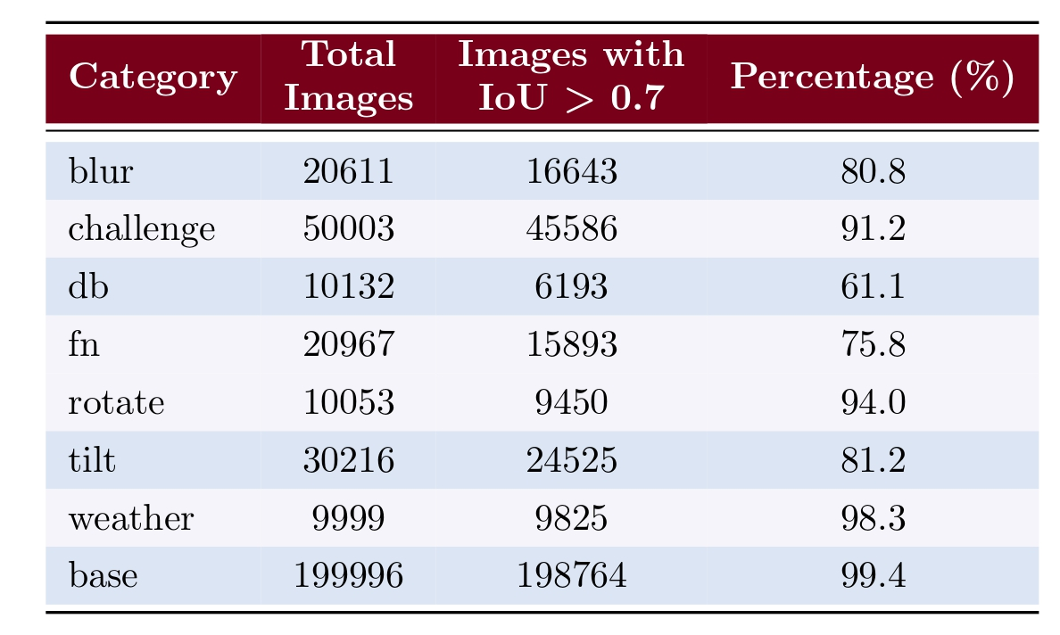
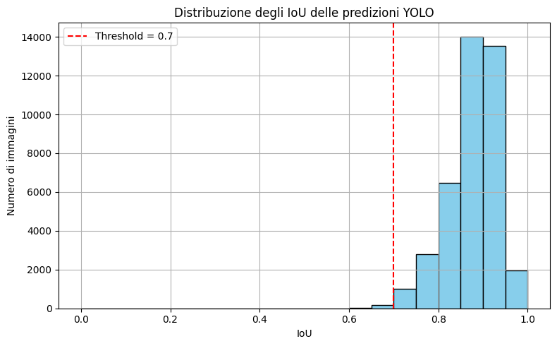
YOLOv5s metrics
Distribution of YOLO Prediction IoUs on base dataset
Percentage of Images with IoU ≥ 70% across Datasets

Slide 19
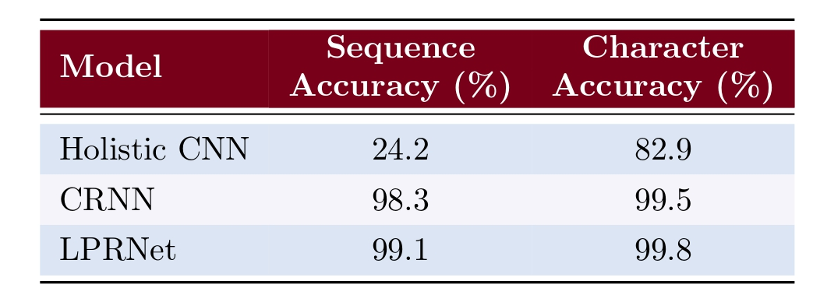
Recognition baseline models performance
All models trained on images from base dataset.
High accuracy on training-like data, low generalization on unseen styles.
Holistic CNN struggles with full sequence prediction.
Performance comparison of recognition models on the base test-set
These baselines show promising results on the base set, but fail to generalize effectively beyond it
Possible improvements could be train on a larger amount of images and enhance data augmentation

Slide 20
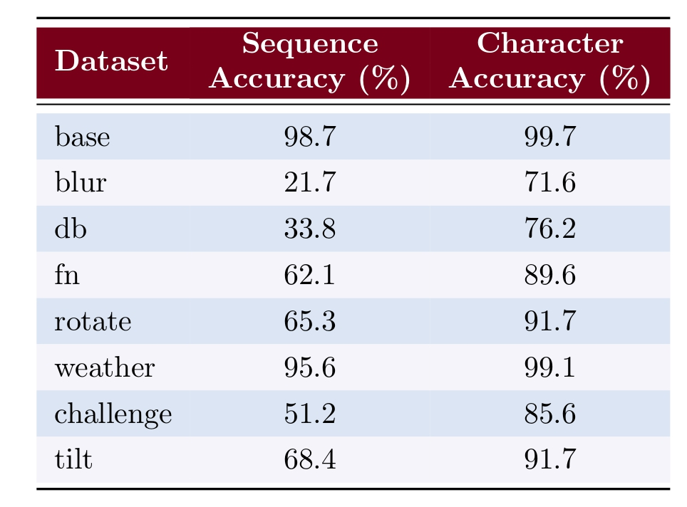
PDLPR metrics on different test datasets

Slide 21
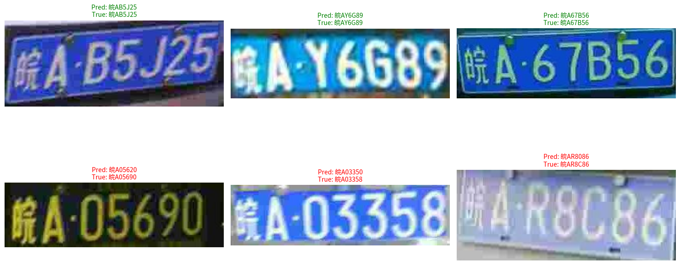
PDLPR model - Successes and Failures
Visual comparison of correctly and incorrectly predicted license plates

Slide 22
Conclusions
Summary of key findings from our experiments
Insights on model performance and comparison
Ideas for improving the system in future work
What we learned and how we can improve

Slide 23
Summary of key findings
PDLPR delivered the best recognition results due to its dedicated parallel decoding and feature extraction.
YOLOv5 significantly outperformed the baseline CNN in detection accuracy and generalization.
LPRNet and CRNN were useful for comparison, but struggled with complex license plates.
End-to-end performance was strongly influenced by detection quality and input clarity.

Slide 24



Future Work
Increase number of real training images
Collect and include more diverse real-world plate images to improve model generalization
Add robust augmentations
Add robust augmentations (blur, occlusion, brightness) to enhance generalization
Experiment with end-to-end joint training
Integrate both tasks in a unified end-to-end architecture for improved accuracy

Slide 25
References
Papers:
1. Tao, L., Hong, S., Lin, Y., Chen, Y., He, P. and Tie, Z. (2024). A Real-Time License Plate Detection and
Recognition Model in Unconstrained Scenarios. Sensors, 24(9), 2791
2. Xu, Z.; Yang, W.; Meng, A.; Lu, N.; Huang, H.; Ying, C.; Huang, L. Towards end-to-end license plate
detection and recognition: A large dataset and baseline. In Proceedings of the European Conference on
Computer Vision (ECCV), Munich, Germany, 8–14 September 2018.
3. R. K. Prajapati, Y. Bhardwaj, R. K. Jain and D. Kamal Kant Hiran, ”A Review Paper on Automatic Num-
ber Plate Recognition using Machine Learning : An In-Depth Analysis of Machine Learning Techniques in Automatic Number Plate Recognition: Opportunities and Limitations,” 2023 International Conference on
Computational Intelligence, Communication Technology and Networking (CICTN), Ghaziabad, India, 2023,
pp. 527-532
Dataset:
https://github.com/detectRecog/CCPD
Slides:
https://github.com/pietro-nardelli/sapienza-ppt-template [Attribution-NonCommercial-ShareAlike 4.0 International (CC BY-NC-SA 4.0)]

Slide 26
Thank you for the attention!

